Slide 1
Intersection of a Line with a Plane or Two Lines

Slide 2
Part 1: The Intersection of a Line with a Plane

Slide 3
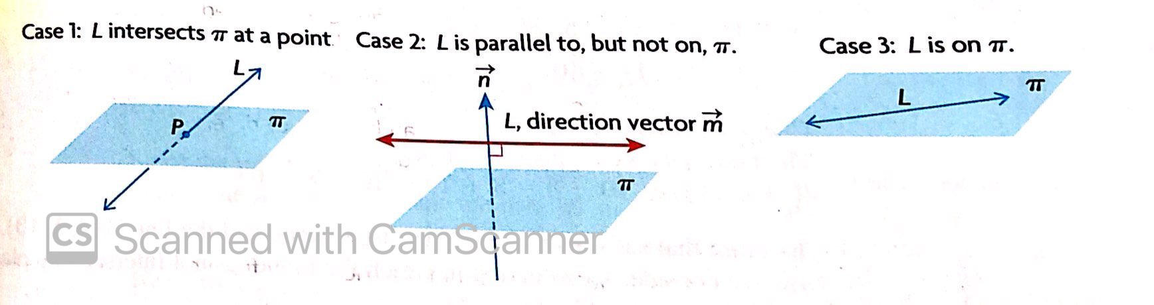
Intersection of a Line with a Plane: 3 Cases
The line L intersects the plane π at exactly one point, P.
The line L does not intersect the plane so it is parallel to the plane. There are no points of intersection.
The line L lies on the plane π. Every point on L intersects the plane. There are an infinite number of points of intersection.

Slide 4
Procedure for Determining the Point(s) of Intersection of a Line with a Plane (if any exist)
Set the parametric expressions for x, y and z into the Cartesian equation
Ax + By + Cz + D = 0.
2. Let’s assume the parameter is t. Solve the equation we get in part 1 above. If we get to 0t = non-zero, then there are no solutions (because it is impossible for 0 times a real number to equal a non-zero quantity). Therefore there are no points of intersection, and we have a situation like case 2 on the previous slide (the line L is parallel to, but not on, the plane π)
3. If we get 0t = 0, then there are an infinite number of solutions, meaning that we have a situation like case 3 on the previous slide (the line L is on the plane π)
4. If we get a non-zero quantity times t equaling a real number, then we have one solution, and we have a situation like case 1 on the previous slide (the line L intersects the plane π at a single point)

Slide 5

Example
Determine the point(s) of intersection, if any, between the line
$L:\vec{r}=\vec{\left(3,1,2\right)}+s\vec{(1,−4,−8)}$ and the plane $π:4x+2y−z−8=0$

Slide 6
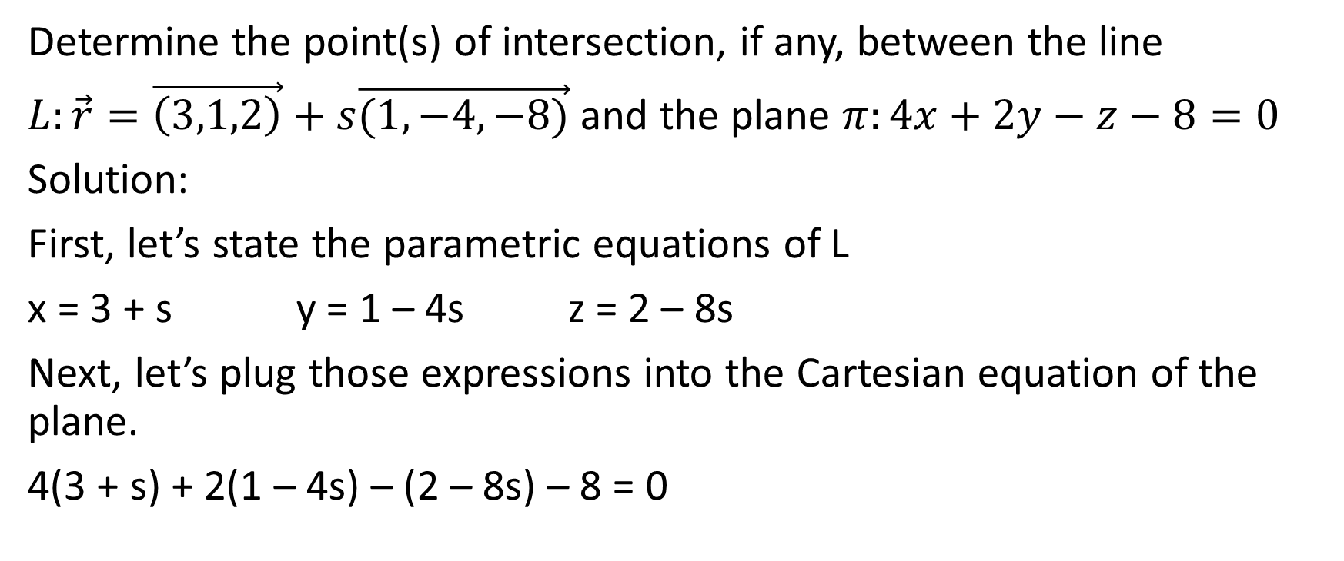
Determine the point(s) of intersection, if any, between the line
$L:\vec{r}=\vec{\left(3,1,2\right)}+s\vec{(1,−4,−8)}$ and the plane $π:4x+2y−z−8=0$
Solution:
First, let’s state the parametric equations of L
x = 3 + s y = 1 – 4s z = 2 – 8s
Next, let’s plug those expressions into the Cartesian equation of the plane.
4(3 + s) + 2(1 – 4s) – (2 – 8s) – 8 = 0

Slide 7
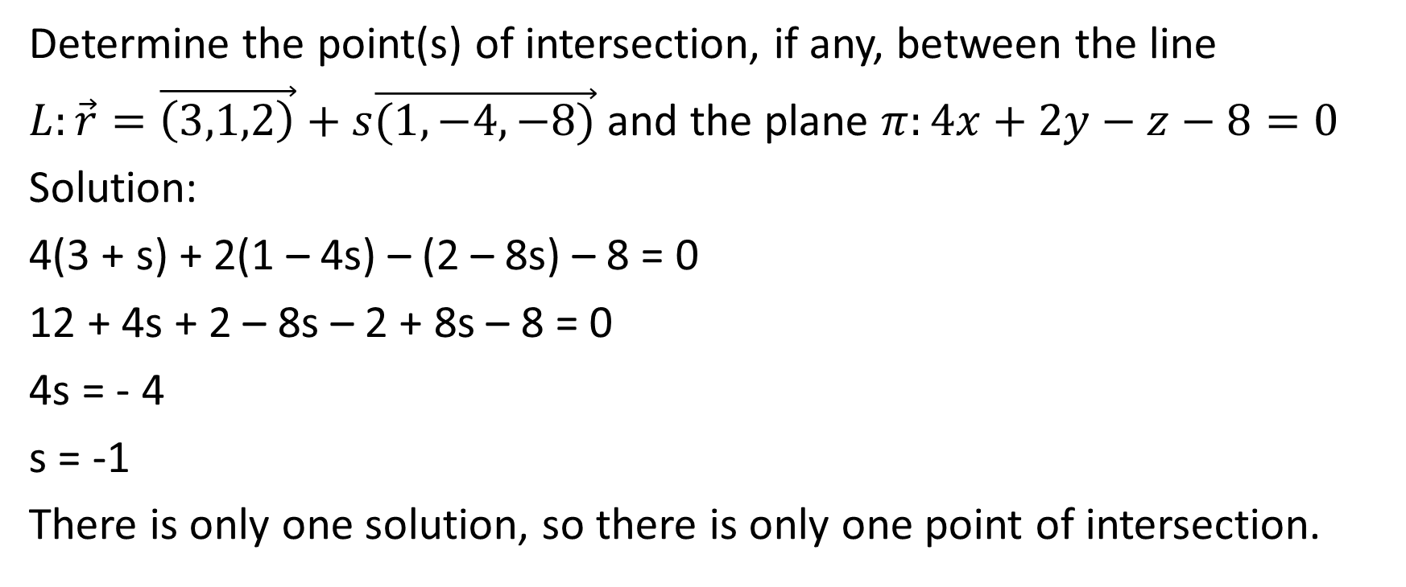
Determine the point(s) of intersection, if any, between the line
$L:\vec{r}=\vec{\left(3,1,2\right)}+s\vec{(1,−4,−8)}$ and the plane $π:4x+2y−z−8=0$
Solution:
4(3 + s) + 2(1 – 4s) – (2 – 8s) – 8 = 0
12 + 4s + 2 – 8s – 2 + 8s – 8 = 0
4s = - 4
s = -1
There is only one solution, so there is only one point of intersection.

Slide 8
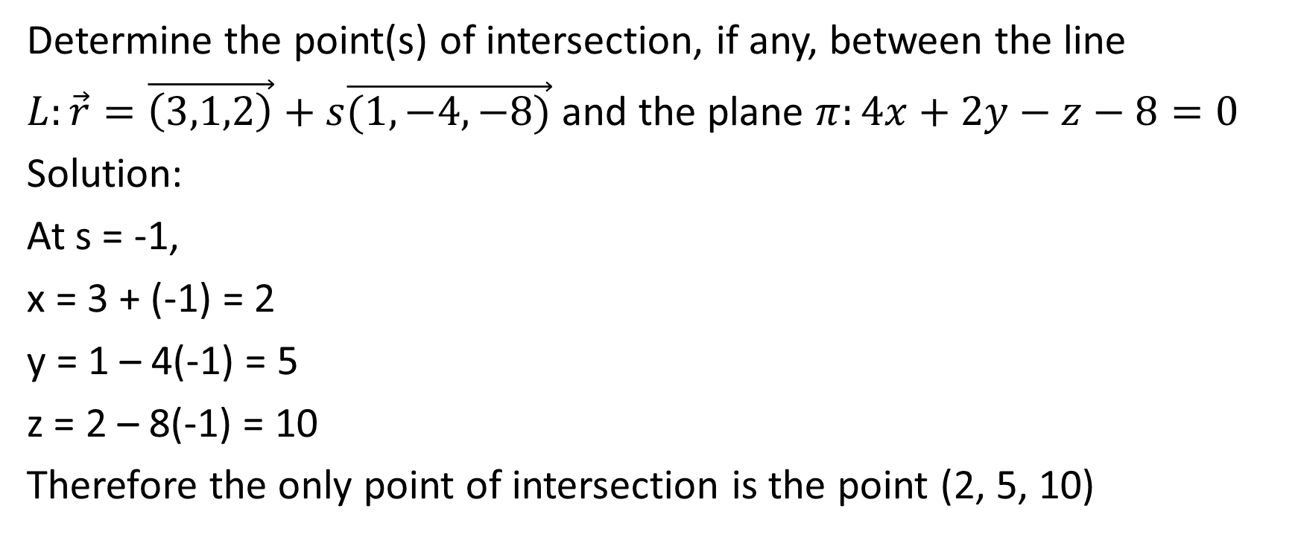
Determine the point(s) of intersection, if any, between the line
$L:\vec{r}=\vec{\left(3,1,2\right)}+s\vec{(1,−4,−8)}$ and the plane $π:4x+2y−z−8=0$
Solution:
At s = -1,
x = 3 + (-1) = 2
y = 1 – 4(-1) = 5
z = 2 – 8(-1) = 10
Therefore the only point of intersection is the point (2, 5, 10)

Slide 9

Example
Determine the points of intersection, if any exist, between the line
$L:x=2+t,y=2+2t,z=9+8t$ and the plane
$π:\vec{r}=\vec{\left(3,1,−5\right)}+m\vec{(1,1,1)}+n\vec{(1,2,8)}$

Slide 10
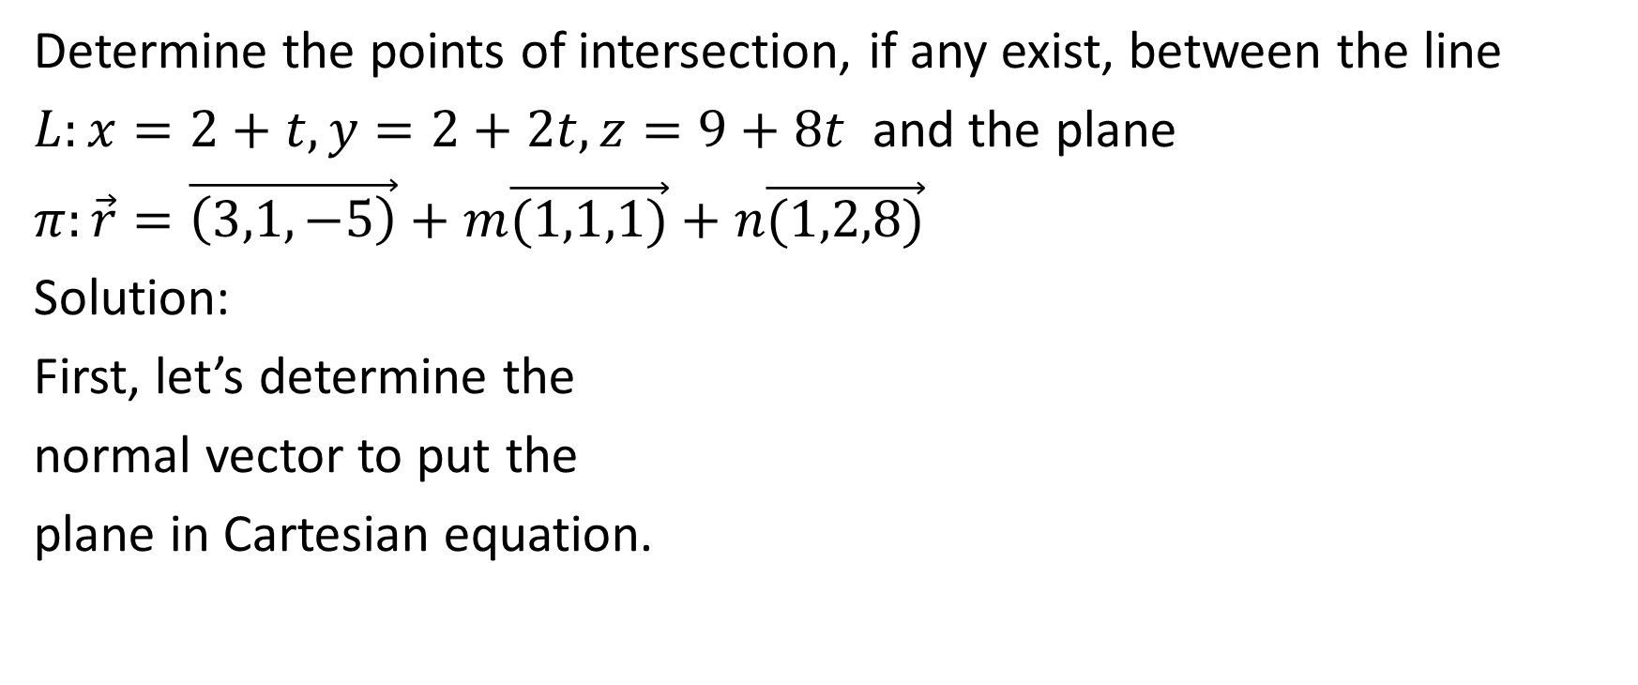
Determine the points of intersection, if any exist, between the line
$L:x=2+t,y=2+2t,z=9+8t$ and the plane
$π:\vec{r}=\vec{\left(3,1,−5\right)}+m\vec{(1,1,1)}+n\vec{(1,2,8)}$
Solution:
First, let’s determine the
normal vector to put the
plane in Cartesian equation.

Slide 11

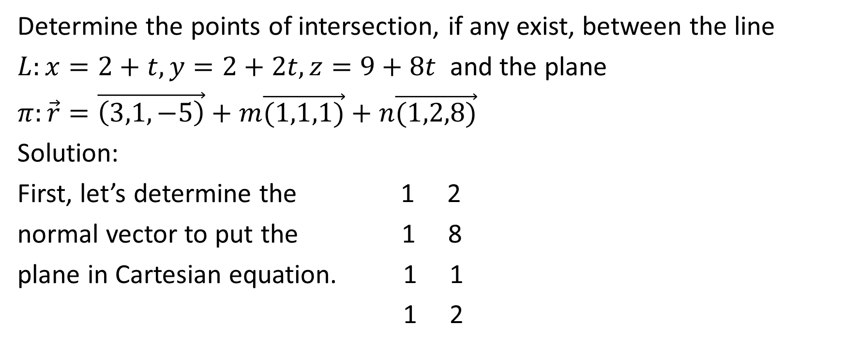




Determine the points of intersection, if any exist, between the line
$L:x=2+t,y=2+2t,z=9+8t$ and the plane
$π:\vec{r}=\vec{\left(3,1,−5\right)}+m\vec{(1,1,1)}+n\vec{(1,2,8)}$
Solution:
First, let’s determine the 1 2
normal vector to put the 1 8
plane in Cartesian equation. 1 1
1 2

Slide 12
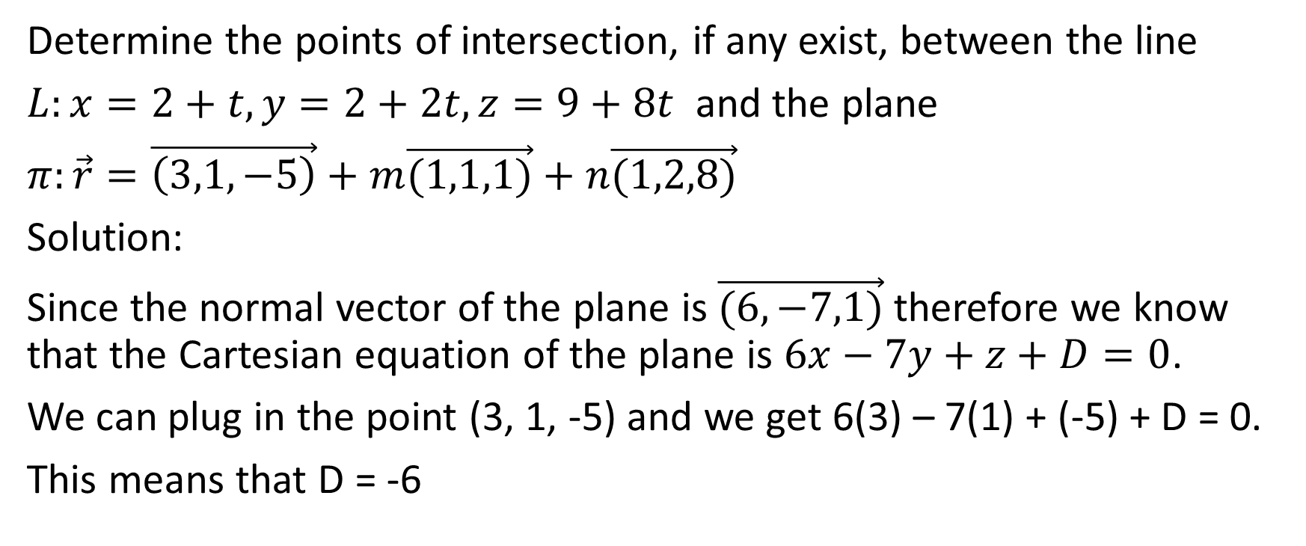
Determine the points of intersection, if any exist, between the line
$L:x=2+t,y=2+2t,z=9+8t$ and the plane
$π:\vec{r}=\vec{\left(3,1,−5\right)}+m\vec{(1,1,1)}+n\vec{(1,2,8)}$
Solution:
Since the normal vector of the plane is $\vec{(6,−7,1)}$ therefore we know that the Cartesian equation of the plane is $6x−7y+z+D=0$.
We can plug in the point (3, 1, -5) and we get 6(3) – 7(1) + (-5) + D = 0.
This means that D = -6

Slide 13
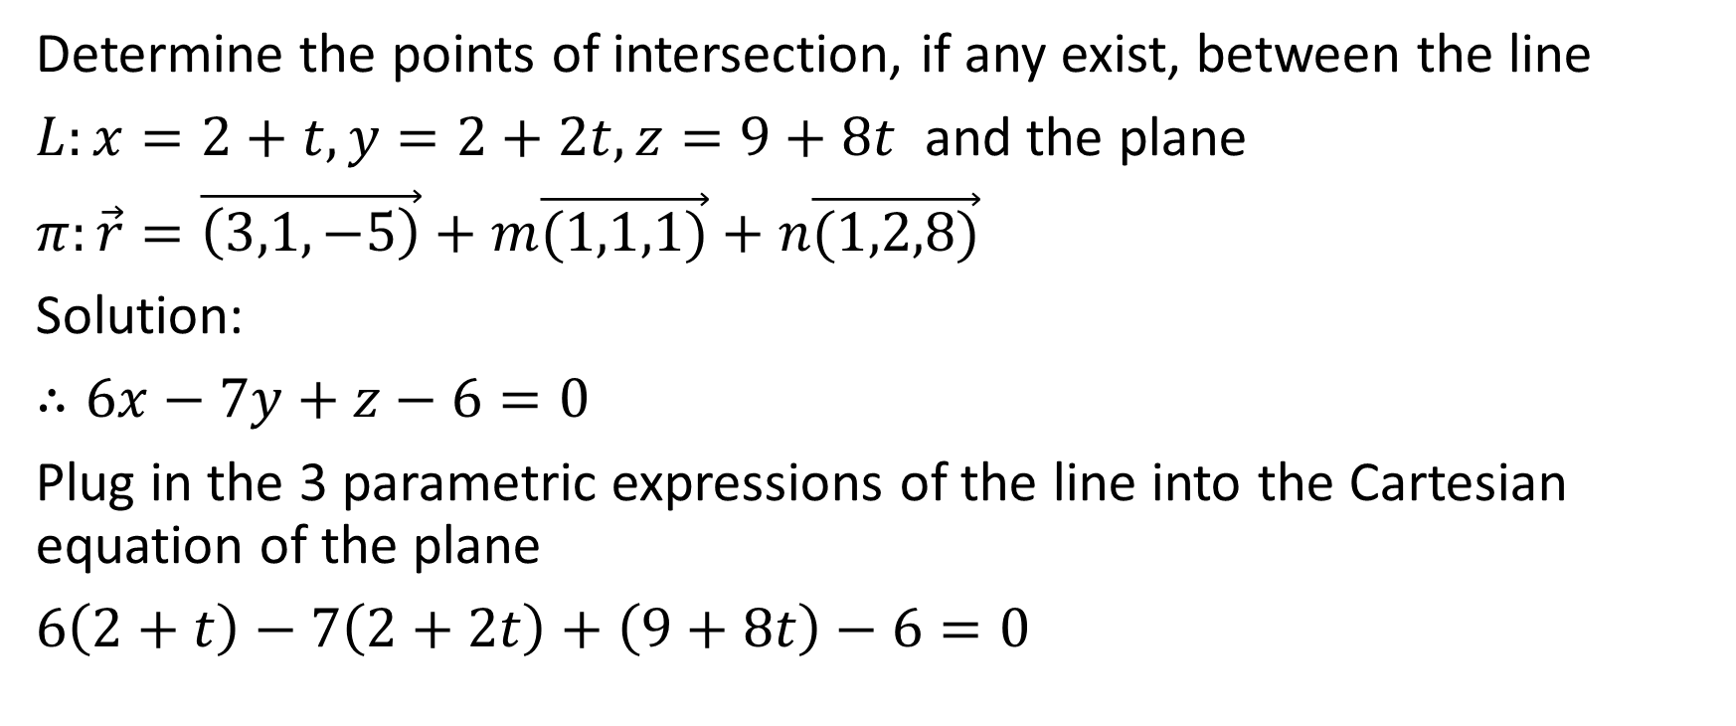
Determine the points of intersection, if any exist, between the line
$L:x=2+t,y=2+2t,z=9+8t$ and the plane
$π:\vec{r}=\vec{\left(3,1,−5\right)}+m\vec{(1,1,1)}+n\vec{(1,2,8)}$
Solution:
$∴6x−7y+z−6=0$
Plug in the 3 parametric expressions of the line into the Cartesian equation of the plane
$6\left(2+t\right)−7\left(2+2t\right)+\left(9+8t\right)−6=0$

Slide 14
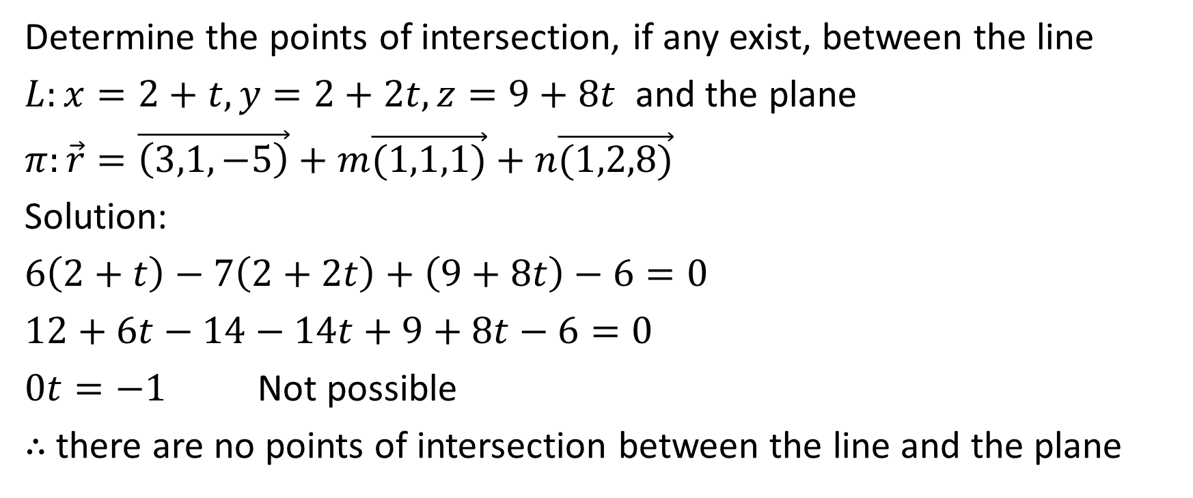
Determine the points of intersection, if any exist, between the line
$L:x=2+t,y=2+2t,z=9+8t$ and the plane
$π:\vec{r}=\vec{\left(3,1,−5\right)}+m\vec{(1,1,1)}+n\vec{(1,2,8)}$
Solution:
$6\left(2+t\right)−7\left(2+2t\right)+\left(9+8t\right)−6=0$
$12+6t−14−14t+9+8t−6=0$
$0t=−1$ Not possible
$∴$ there are no points of intersection between the line and the plane

Slide 15
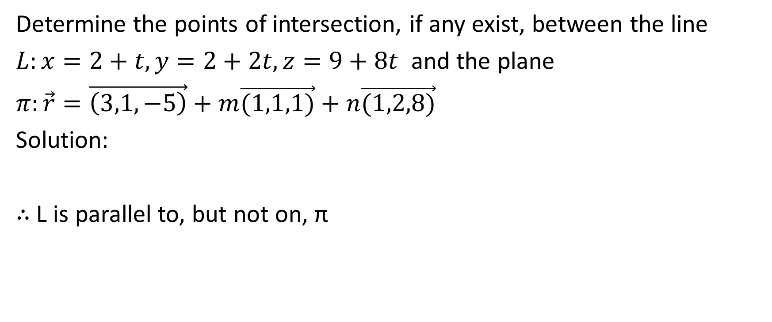
Determine the points of intersection, if any exist, between the line
$L:x=2+t,y=2+2t,z=9+8t$ and the plane
$π:\vec{r}=\vec{\left(3,1,−5\right)}+m\vec{(1,1,1)}+n\vec{(1,2,8)}$
Solution:
$∴$ L is parallel to, but not on, π

Slide 16

Example
Determine the point(s) of intersection, if any exist, between the line $L:\vec{r}=\vec{(3,−2,1)}+s\vec{(14,−5,−3)}$ and the plane
$π:x+y+3z−4=0$

Slide 17
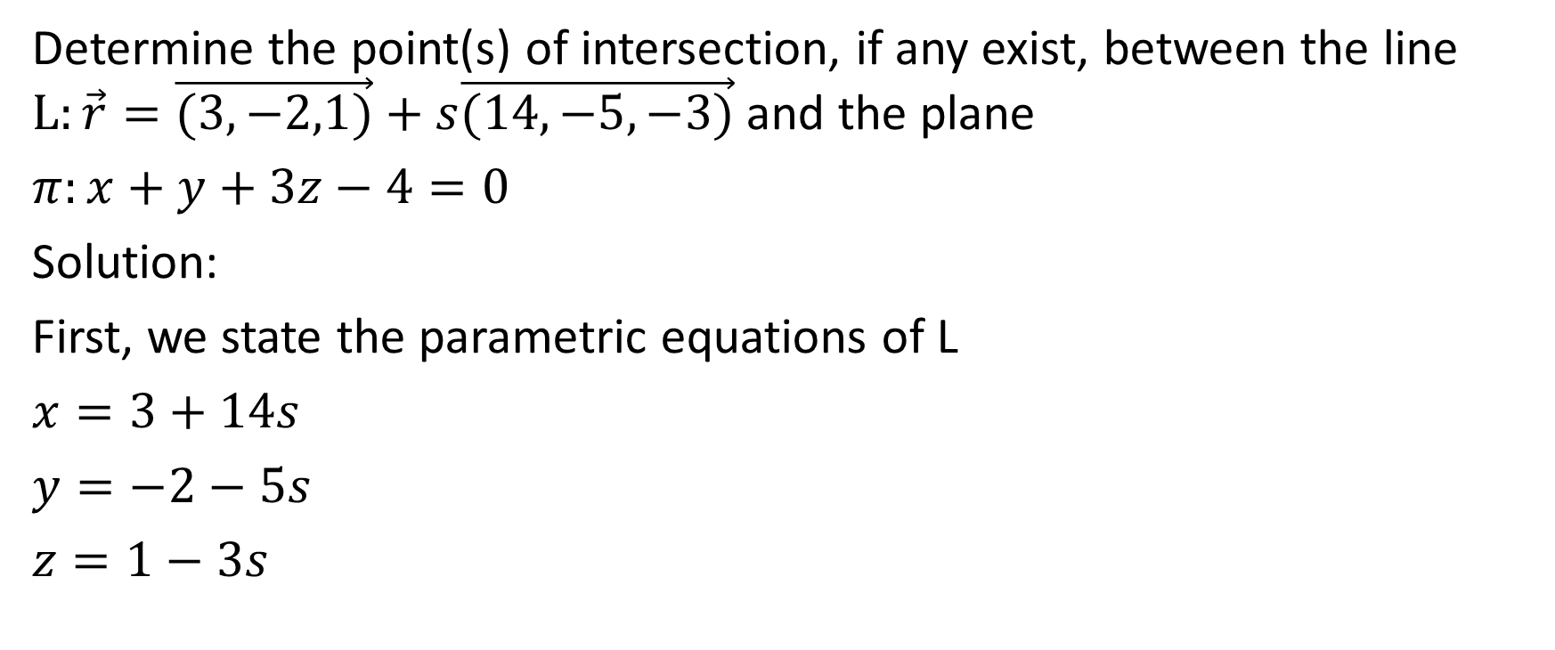
Determine the point(s) of intersection, if any exist, between the line $L:\vec{r}=\vec{(3,−2,1)}+s\vec{(14,−5,−3)}$ and the plane
$π:x+y+3z−4=0$
Solution:
First, we state the parametric equations of L
$x=3+14s$
$y=−2−5s$
$z=1−3s$

Slide 18
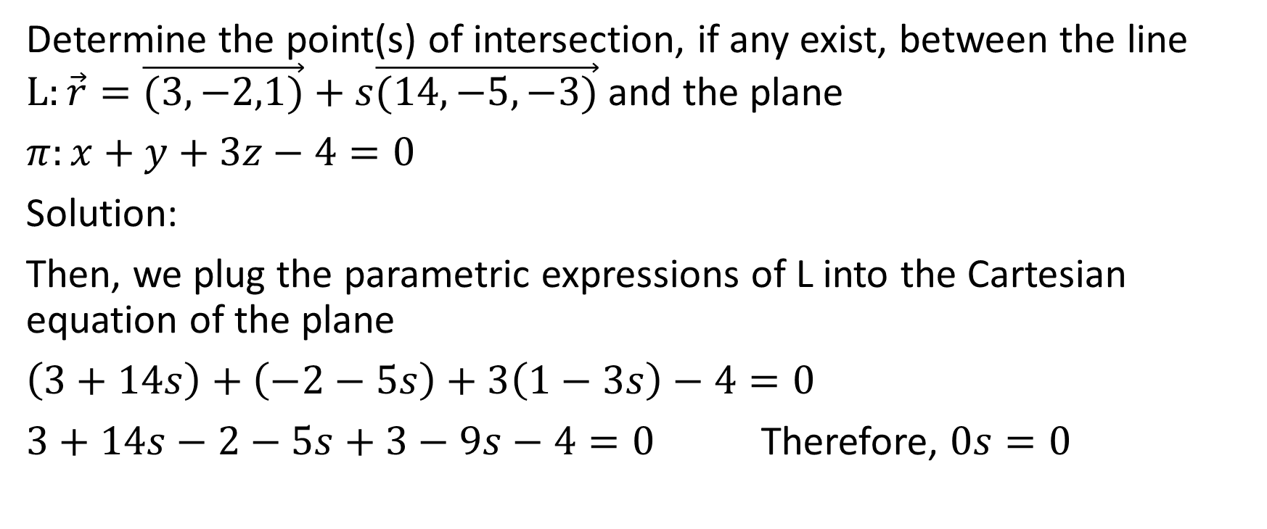
Determine the point(s) of intersection, if any exist, between the line $L:\vec{r}=\vec{(3,−2,1)}+s\vec{(14,−5,−3)}$ and the plane
$π:x+y+3z−4=0$
Solution:
Then, we plug the parametric expressions of L into the Cartesian equation of the plane
$\left(3+14s\right)+\left(−2−5s\right)+3\left(1−3s\right)−4=0$
$3+14s−2−5s+3−9s−4=0$ Therefore, $0s=0$

Slide 19
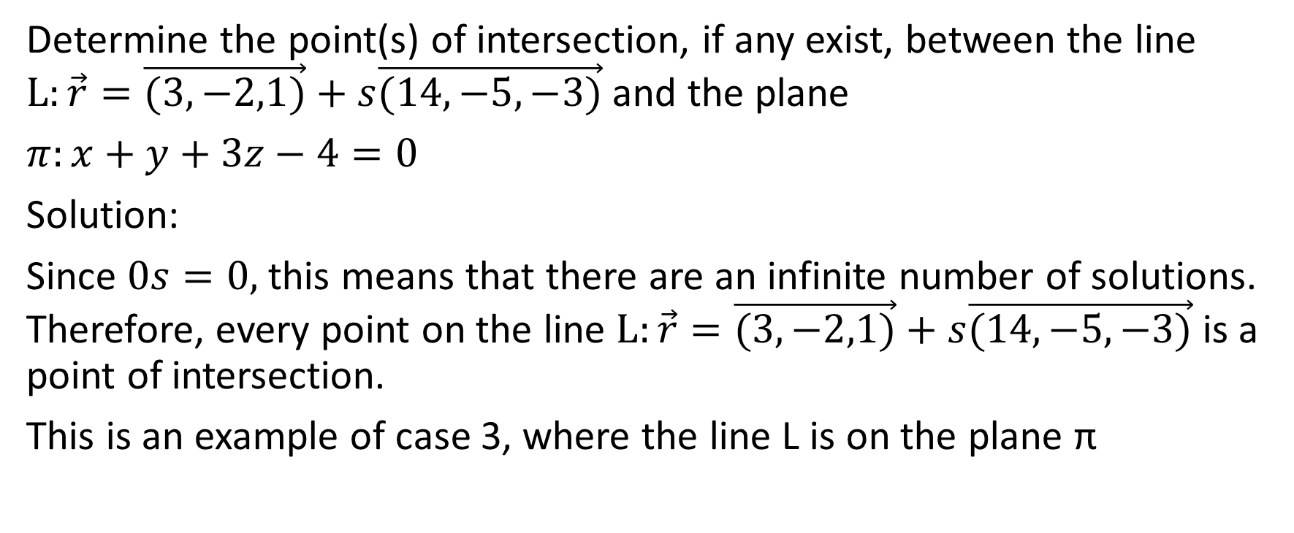
Determine the point(s) of intersection, if any exist, between the line $L:\vec{r}=\vec{(3,−2,1)}+s\vec{(14,−5,−3)}$ and the plane
$π:x+y+3z−4=0$
Solution:
Since $0s=0,$ this means that there are an infinite number of solutions. Therefore, every point on the line $L:\vec{r}=\vec{(3,−2,1)}+s\vec{(14,−5,−3)}$ is a point of intersection.
This is an example of case 3, where the line L is on the plane π

Slide 20
Part 2: The Intersection of Two Lines

Slide 21
Intersection of Two Lines: 4 Cases
Two lines intersect at a single point if
The direction vectors are not collinear, and
We algebraically determine a point of intersection
Two lines are coincident if
The direction vectors are collinear, and
We algebraically determine a point of intersection
Two lines are parallel & non-coincident (no points of intersection) if
The direction vectors are collinear, and
We determine that one point on one of the lines is not on the other line
Two lines are skew (non points of intersection) if
The direction vectors are not collinear, and
We algebraically determine that there are no points of intersection

Slide 22
Two lines intersect at a single point if
The direction vectors are not collinear, and
We algebraically determine a point of intersection
Two lines are coincident if
The direction vectors are collinear, and
We algebraically determine a point of intersection
Two lines are parallel & non-coincident (no points of intersection) if
The direction vectors are collinear, and
We determine that one point on one of the lines is not on the other line
Two lines are skew (non points of intersection) if
The direction vectors are not collinear, and
We algebraically determine that there are no points of intersection

Slide 23
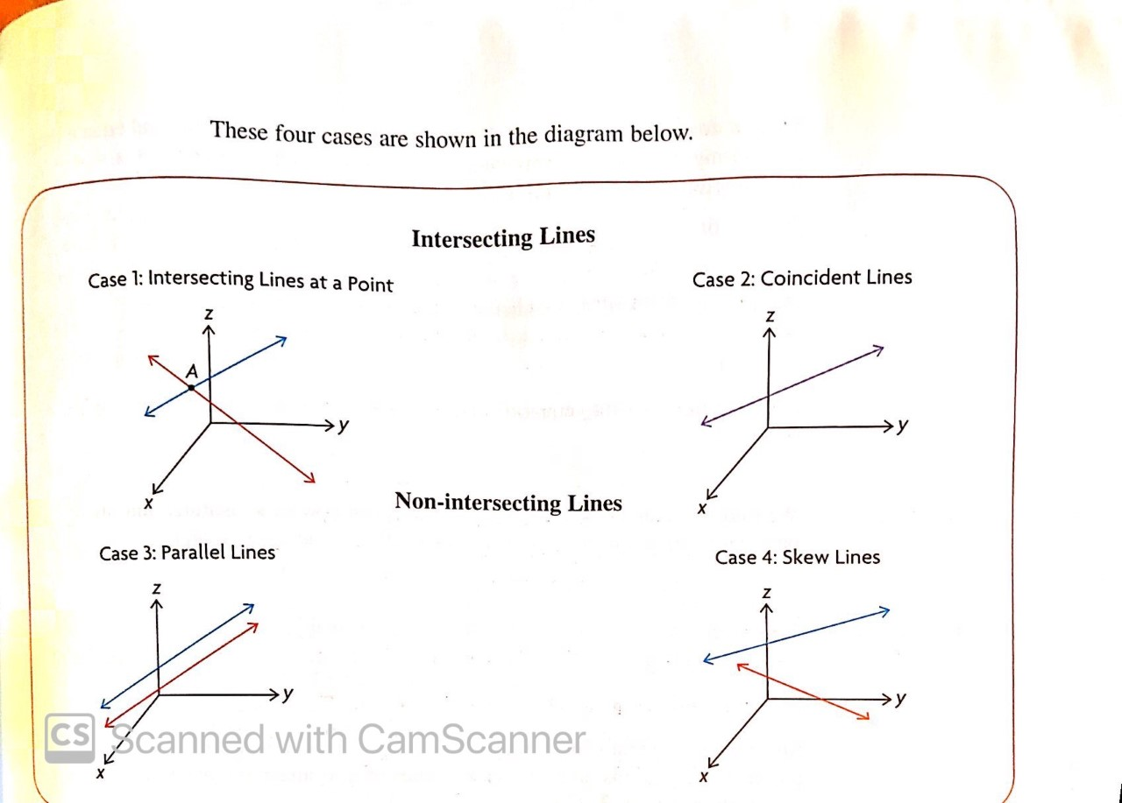
Two lines intersect at a single point if
The direction vectors are not collinear, and
We algebraically determine a point of intersection
Two lines are coincident if
The direction vectors are collinear, and
We algebraically determine a point of intersection
Two lines are parallel & non-coincident (no points of intersection) if
The direction vectors are collinear, and
We determine that one point on one of the lines is not on the other line
Two lines are skew (non points of intersection) if
The direction vectors are not collinear, and
We algebraically determine that there are no points of intersection

Slide 24

Example
Determine the point(s) of intersection, if any, of the lines
$L_{1}:\vec{r}=\vec{(9,1,0)}+s\vec{(4,−1,−2)},s∈R$ and
$L_{2}:\vec{r}=\vec{(−4,−1,10)}+t\vec{(5,4,−6)}, t$ $∈R$

Slide 25
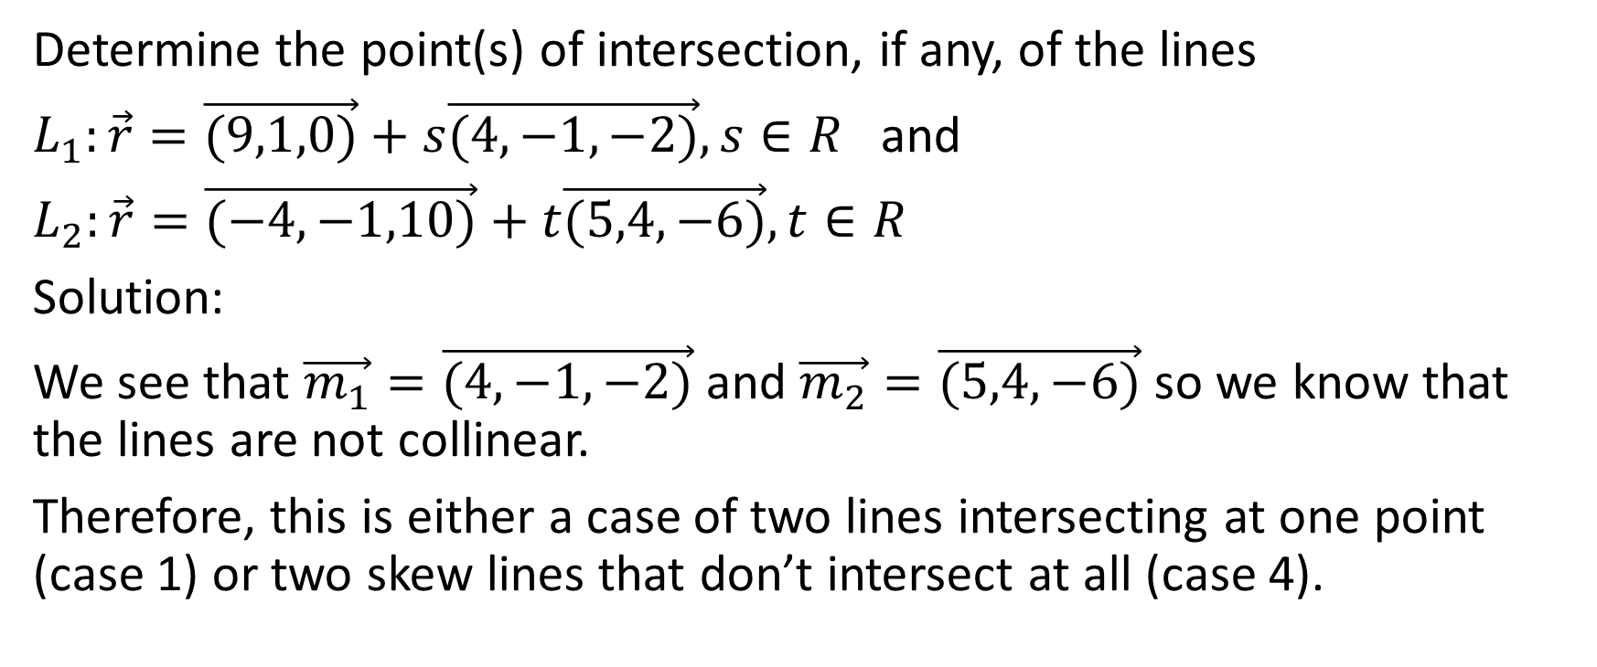
Determine the point(s) of intersection, if any, of the lines
$L_{1}:\vec{r}=\vec{(9,1,0)}+s\vec{(4,−1,−2)},s∈R$ and
$L_{2}:\vec{r}=\vec{(−4,−1,10)}+t\vec{(5,4,−6)},t∈R$
Solution:
We see that $\vec{m_{1}}=\vec{(4,−1,−2)}$ and $\vec{m_{2}}=\vec{(5,4,−6)}$ so we know that the lines are not collinear.
Therefore, this is either a case of two lines intersecting at one point (case 1) or two skew lines that don’t intersect at all (case 4).

Slide 26
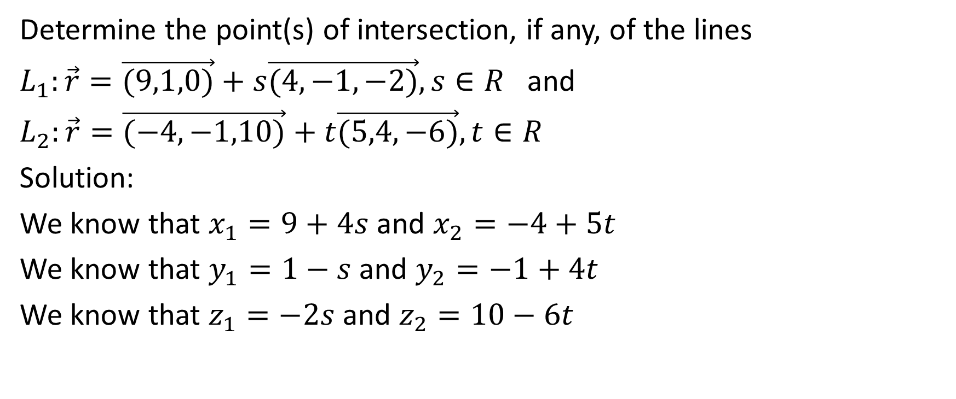
Determine the point(s) of intersection, if any, of the lines
$L_{1}:\vec{r}=\vec{(9,1,0)}+s\vec{(4,−1,−2)},s∈R$ and
$L_{2}:\vec{r}=\vec{(−4,−1,10)}+t\vec{(5,4,−6)},t∈R$
Solution:
We know that $x_{1}=9+4s$ and $x_{2}=−4+5t$
We know that $y_{1}=1−s$ and $y_{2}=−1+4t$
We know that $z_{1}=−2s$ and $z_{2}=10−6t$

Slide 27
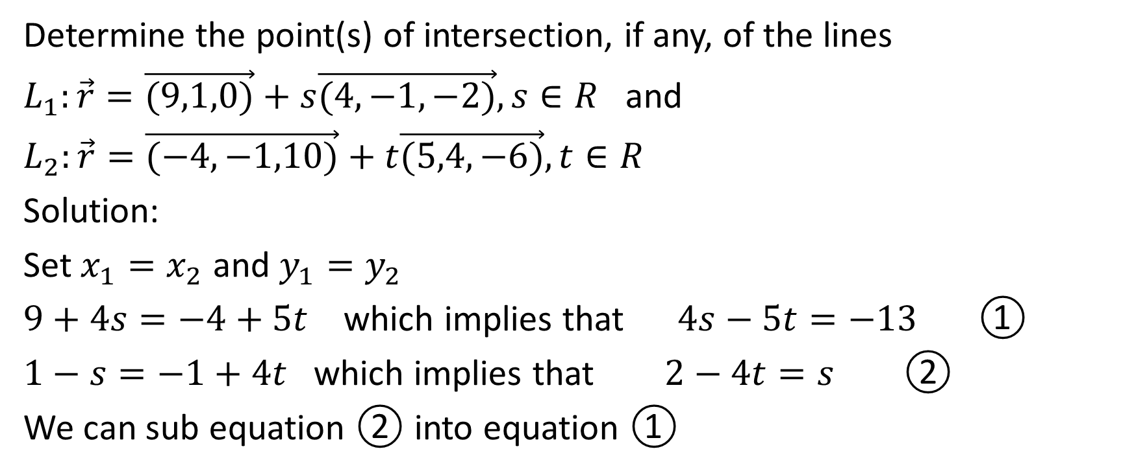
Determine the point(s) of intersection, if any, of the lines
$L_{1}:\vec{r}=\vec{(9,1,0)}+s\vec{(4,−1,−2)},s∈R$ and
$L_{2}:\vec{r}=\vec{(−4,−1,10)}+t\vec{(5,4,−6)},t∈R$
Solution:
Set $x_{1}=x_{2}$ and $y_{1}=y_{2}$
$9+4s=−4+5t$ which implies that $4s−5t=−13$ ①
$1−s=−1+4t$ which implies that $2−4t=s$ ②
We can sub equation ② into equation ①

Slide 28
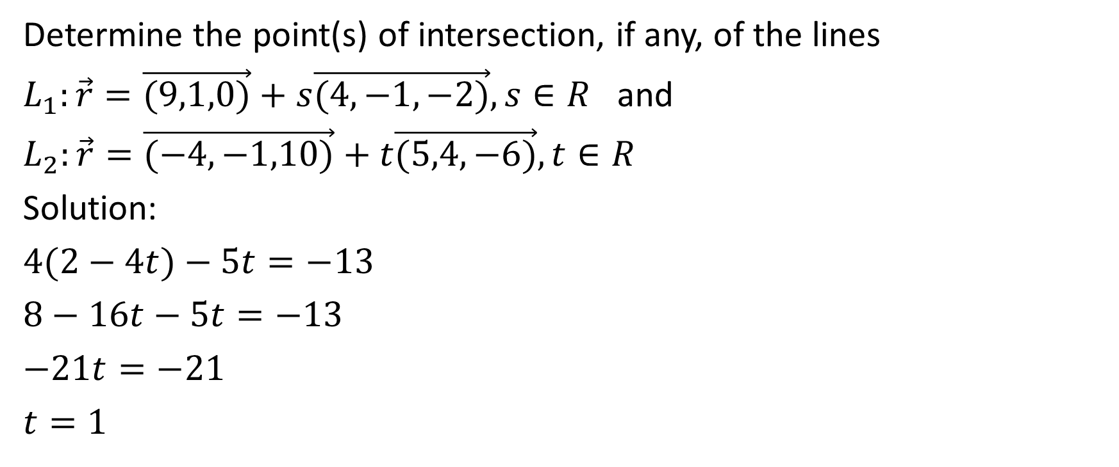
Determine the point(s) of intersection, if any, of the lines
$L_{1}:\vec{r}=\vec{(9,1,0)}+s\vec{(4,−1,−2)},s∈R$ and
$L_{2}:\vec{r}=\vec{(−4,−1,10)}+t\vec{(5,4,−6)},t∈R$
Solution:
$4(2−4t)−5t=−13$
$8−16t−5t=−13$
$−21t=−21$
$t=1$

Slide 29
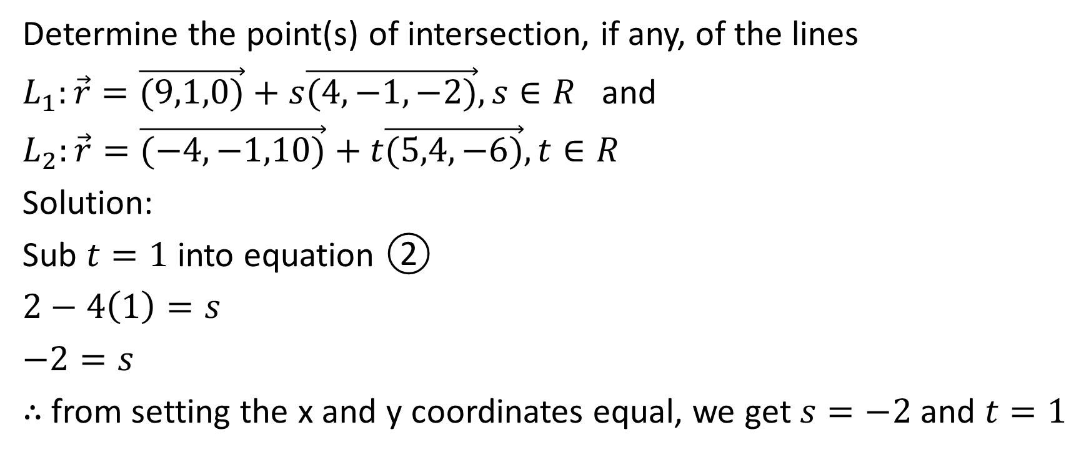
Determine the point(s) of intersection, if any, of the lines
$L_{1}:\vec{r}=\vec{(9,1,0)}+s\vec{(4,−1,−2)},s∈R$ and
$L_{2}:\vec{r}=\vec{(−4,−1,10)}+t\vec{(5,4,−6)},t∈R$
Solution:
Sub $t=1$ into equation ②
$2−4\left(1\right)=s$
$−2=s$
$∴$ from setting the x and y coordinates equal, we get $s=−2$ and $t=1$

Slide 30
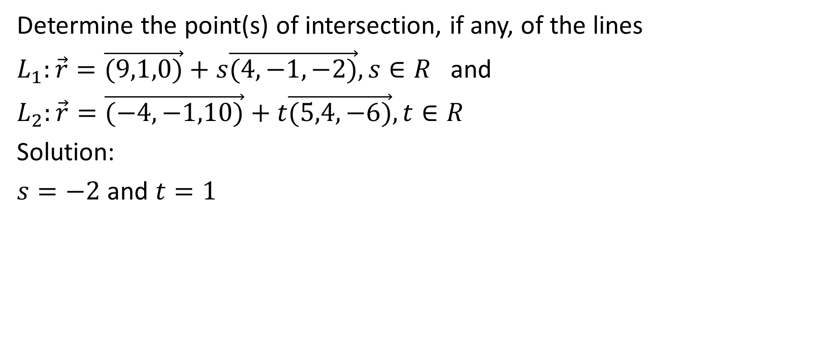
Determine the point(s) of intersection, if any, of the lines
$L_{1}:\vec{r}=\vec{(9,1,0)}+s\vec{(4,−1,−2)},s∈R$ and
$L_{2}:\vec{r}=\vec{(−4,−1,10)}+t\vec{(5,4,−6)},t∈R$
Solution:
$s=−2$ and $t=1$

Slide 31
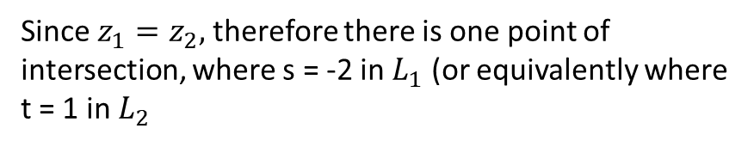
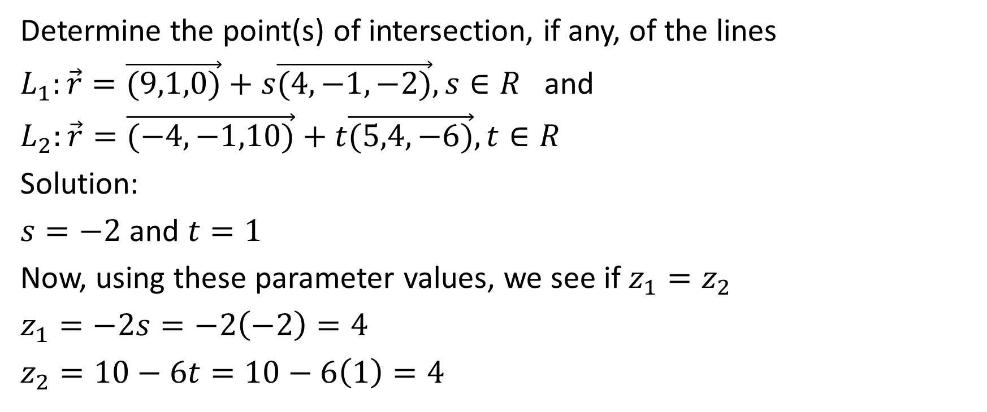
Determine the point(s) of intersection, if any, of the lines
$L_{1}:\vec{r}=\vec{(9,1,0)}+s\vec{(4,−1,−2)},s∈R$ and
$L_{2}:\vec{r}=\vec{(−4,−1,10)}+t\vec{(5,4,−6)},t∈R$
Solution:
$s=−2$ and $t=1$
Now, using these parameter values, we see if $z_{1}=z_{2}$
$z_{1}=−2s=−2\left(−2\right)=4$
$z_{2}=10−6t=10−6\left(1\right)=4$
Since $z_{1}=z_{2},$therefore there is one point of intersection, where s = -2 in $L_{1}$ (or equivalently where t = 1 in $L_{2}$

Slide 32
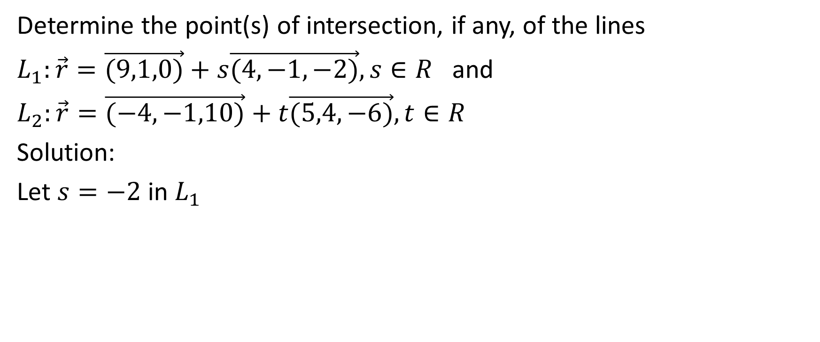
Determine the point(s) of intersection, if any, of the lines
$L_{1}:\vec{r}=\vec{(9,1,0)}+s\vec{(4,−1,−2)},s∈R$ and
$L_{2}:\vec{r}=\vec{(−4,−1,10)}+t\vec{(5,4,−6)},t∈R$
Solution:
Let $s=−2$ in $L_{1}$

Slide 33
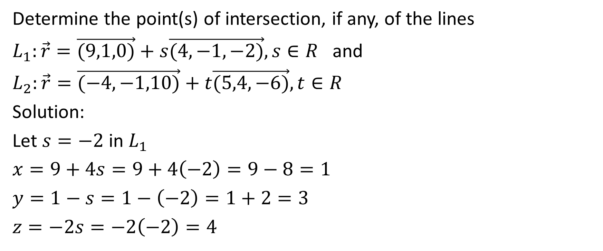
Determine the point(s) of intersection, if any, of the lines
$L_{1}:\vec{r}=\vec{(9,1,0)}+s\vec{(4,−1,−2)},s∈R$ and
$L_{2}:\vec{r}=\vec{(−4,−1,10)}+t\vec{(5,4,−6)},t∈R$
Solution:
Let $s=−2$ in $L_{1}$
$x=9+4s=9+4\left(−2\right)=9−8=1$
$y=1−s=1−\left(−2\right)=1+2=3$
$z=−2s=−2\left(−2\right)=4$

Slide 34
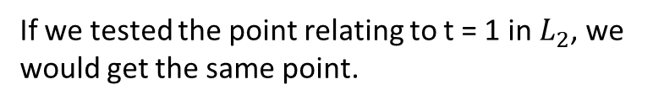
Determine the point(s) of intersection, if any, of the lines
$L_{1}:\vec{r}=\vec{(9,1,0)}+s\vec{(4,−1,−2)},s∈R$ and
$L_{2}:\vec{r}=\vec{(−4,−1,10)}+t\vec{(5,4,−6)},t∈R$
Solution:
Let $s=−2$ in $L_{1}$
$x=9+4s=9+4\left(−2\right)=9−8=1$
$y=1−s=1−\left(−2\right)=1+2=3$
$z=−2s=−2\left(−2\right)=4$
If we tested the point relating to t = 1 in $L_{2}$, we would get the same point.

Slide 35
Determine the point(s) of intersection, if any, of the lines
$L_{1}:\vec{r}=\vec{(9,1,0)}+s\vec{(4,−1,−2)},s∈R$ and
$L_{2}:\vec{r}=\vec{(−4,−1,10)}+t\vec{(5,4,−6)},t∈R$
Solution:
Let $s=−2$ in $L_{1}$
$x=9+4s=9+4\left(−2\right)=9−8=1$
$y=1−s=1−\left(−2\right)=1+2=3$
$z=−2s=−2\left(−2\right)=4$
Therefore the only point of intersection of these two lines is (1, 3, 4)

Slide 36

Example
Determine the point(s) of intersection, if any, of the lines
$L_{1}:\vec{r}=\vec{(3,0,−1)}+s\vec{(1,−2,−3)},s∈R$ and
$L_{2}:\vec{r}=\vec{(−2,−3,−8)}+t\vec{\left(8,1,0\right)},t∈R$

Slide 37
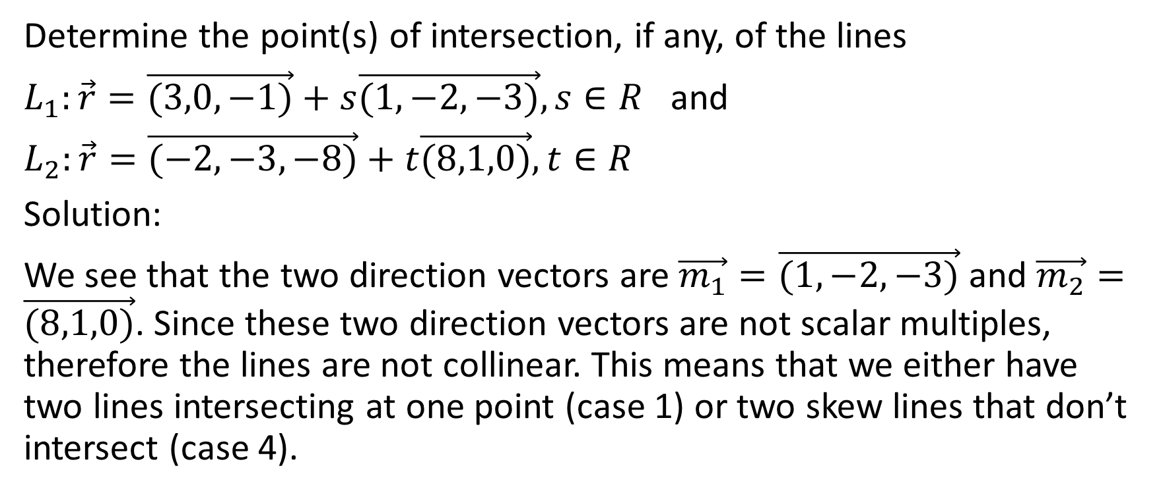
Determine the point(s) of intersection, if any, of the lines
$L_{1}:\vec{r}=\vec{(3,0,−1)}+s\vec{(1,−2,−3)},s∈R$ and
$L_{2}:\vec{r}=\vec{(−2,−3,−8)}+t\vec{(8,1,0)},t∈R$
Solution:
We see that the two direction vectors are $\vec{m_{1}}=\vec{(1,−2,−3)}$ and $\vec{m_{2}}=\vec{(8,1,0)}$. Since these two direction vectors are not scalar multiples, therefore the lines are not collinear. This means that we either have two lines intersecting at one point (case 1) or two skew lines that don’t intersect (case 4).

Slide 38
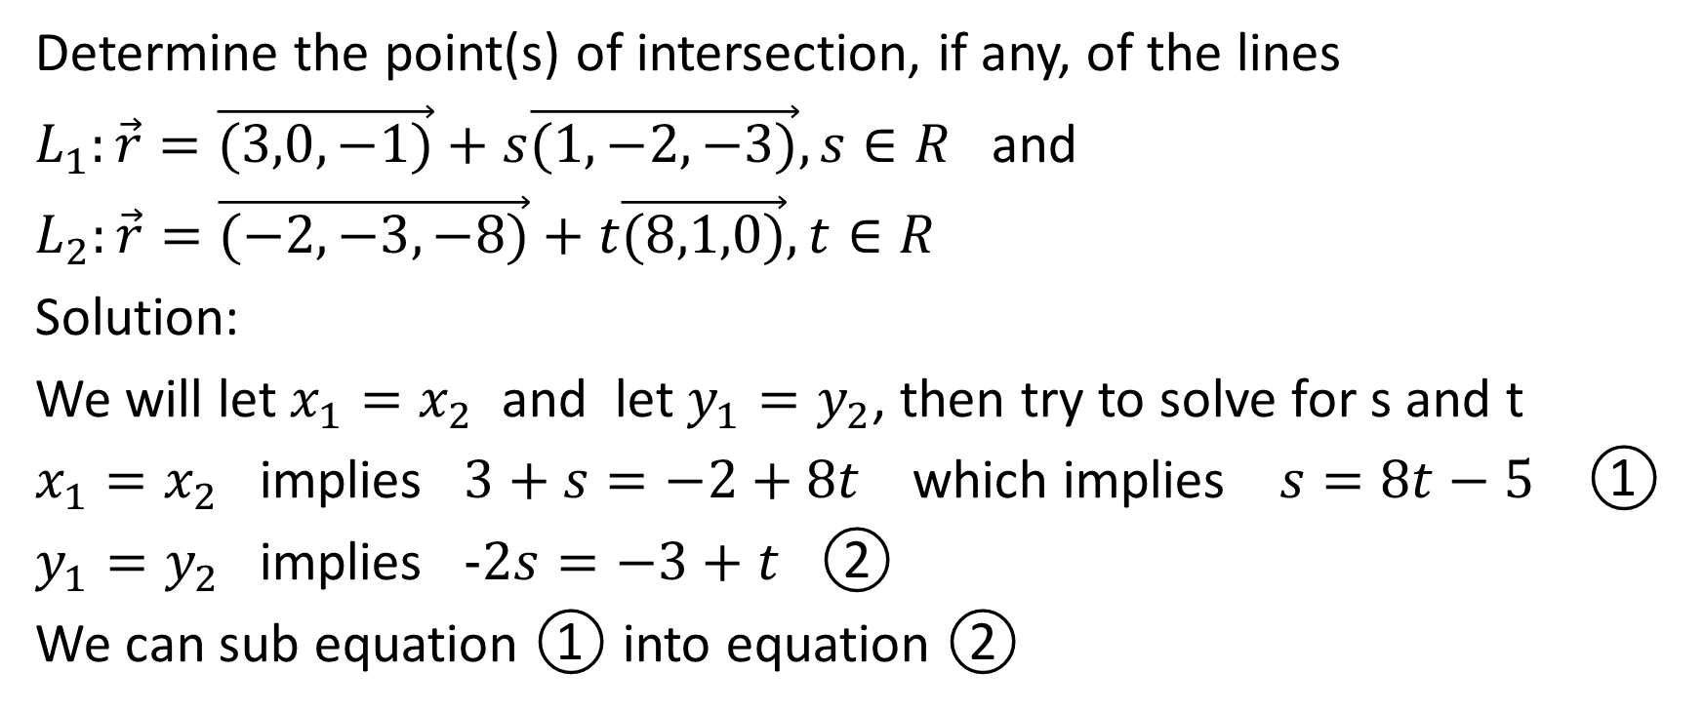
Determine the point(s) of intersection, if any, of the lines
$L_{1}:\vec{r}=\vec{(3,0,−1)}+s\vec{(1,−2,−3)},s∈R$ and
$L_{2}:\vec{r}=\vec{(−2,−3,−8)}+t\vec{(8,1,0)},t∈R$
Solution:
We will let $x_{1}=x_{2}$ and let $y_{1}=y_{2}$, then try to solve for s and t
$x_{1}=x_{2}$ implies $3+s=−2+8t$ which implies $s=8t−5$ ①
$y_{1}=y_{2}$ implies $−2s=−3+t$ ②
We can sub equation ① into equation ②

Slide 39
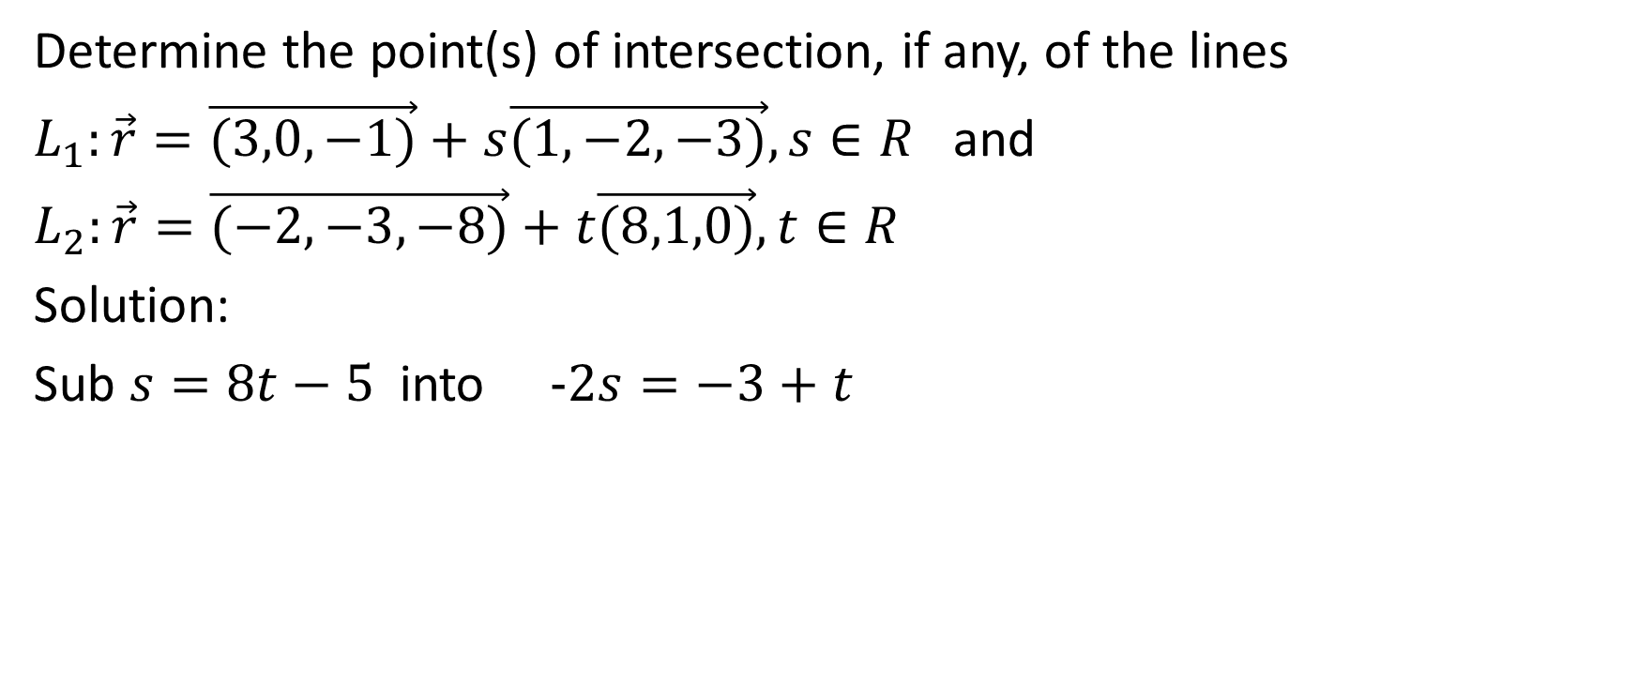
Determine the point(s) of intersection, if any, of the lines
$L_{1}:\vec{r}=\vec{(3,0,−1)}+s\vec{(1,−2,−3)},s∈R$ and
$L_{2}:\vec{r}=\vec{(−2,−3,−8)}+t\vec{(8,1,0)},t∈R$
Solution:
Sub $s=8t−5$ into $−2s=−3+t$

Slide 40
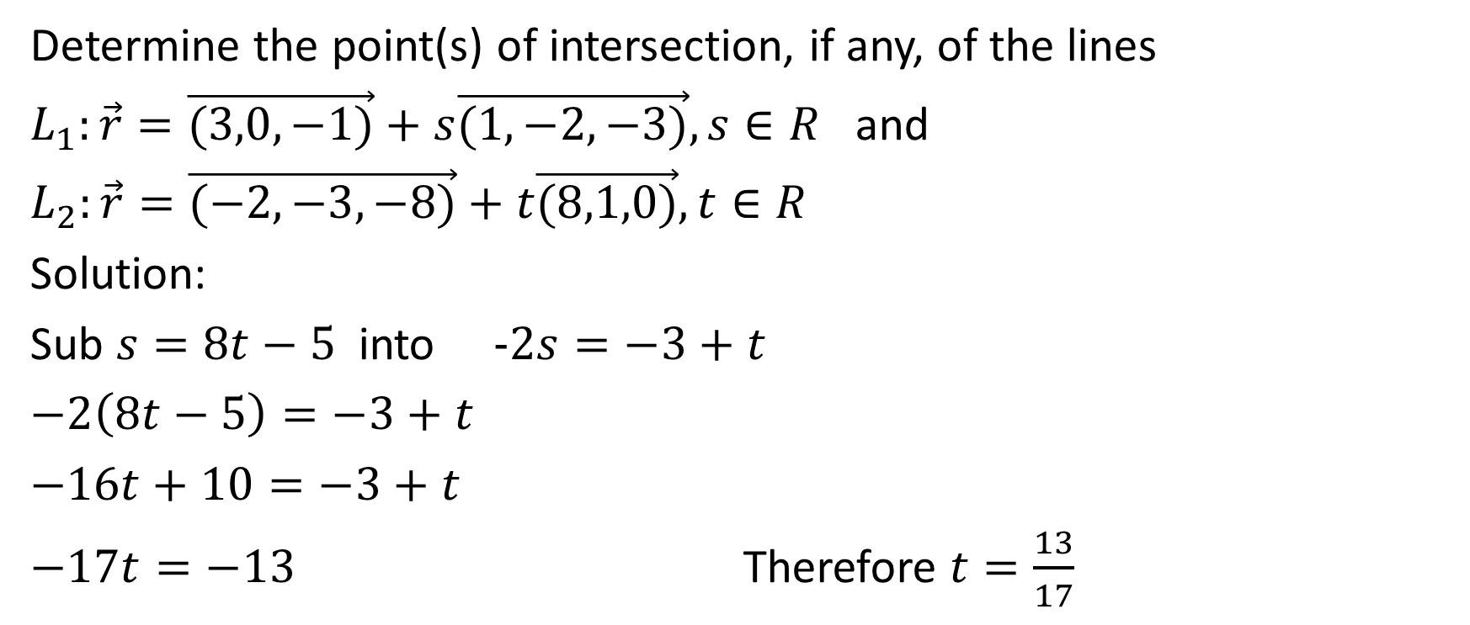
Determine the point(s) of intersection, if any, of the lines
$L_{1}:\vec{r}=\vec{(3,0,−1)}+s\vec{(1,−2,−3)},s∈R$ and
$L_{2}:\vec{r}=\vec{(−2,−3,−8)}+t\vec{(8,1,0)},t∈R$
Solution:
Sub $s=8t−5$ into $−2s=−3+t$
$−2\left(8t−5\right)=−3+t$
$−16t+10=−3+t$
$−17t=−13$ Therefore $t=\frac{13}{17}$

Slide 41
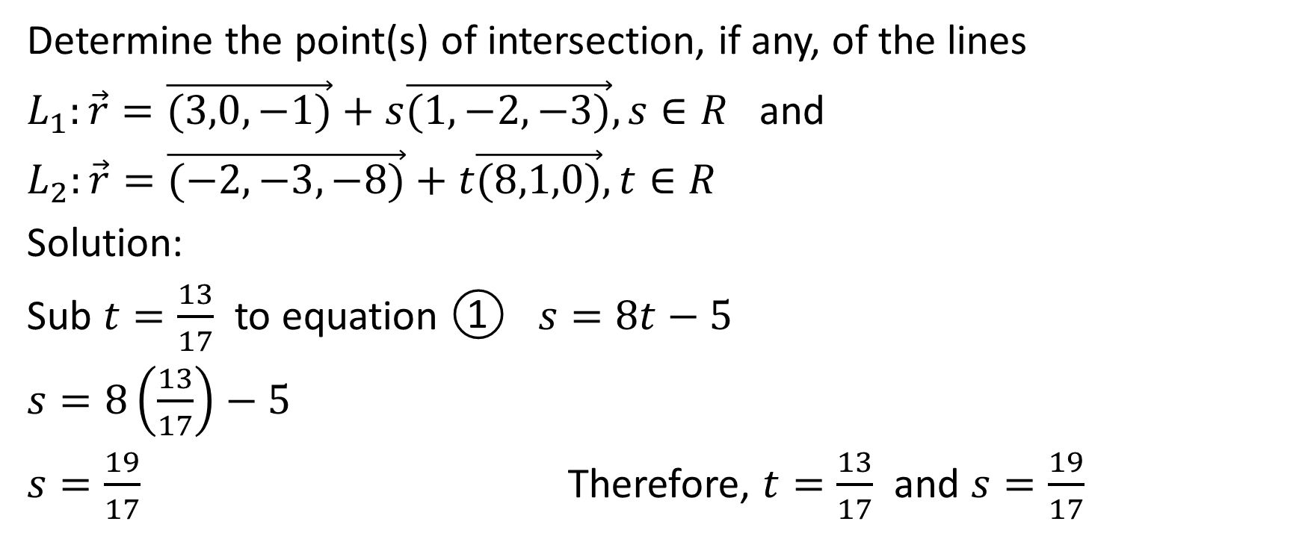
Determine the point(s) of intersection, if any, of the lines
$L_{1}:\vec{r}=\vec{(3,0,−1)}+s\vec{(1,−2,−3)},s∈R$ and
$L_{2}:\vec{r}=\vec{(−2,−3,−8)}+t\vec{(8,1,0)},t∈R$
Solution:
Sub $t=\frac{13}{17}$ to equation ① $s=8t−5$
$s=8\left(\frac{13}{17}\right)−5$
$s=\frac{19}{17}$ Therefore, $t=\frac{13}{17}$ and $s=\frac{19}{17}$

Slide 42
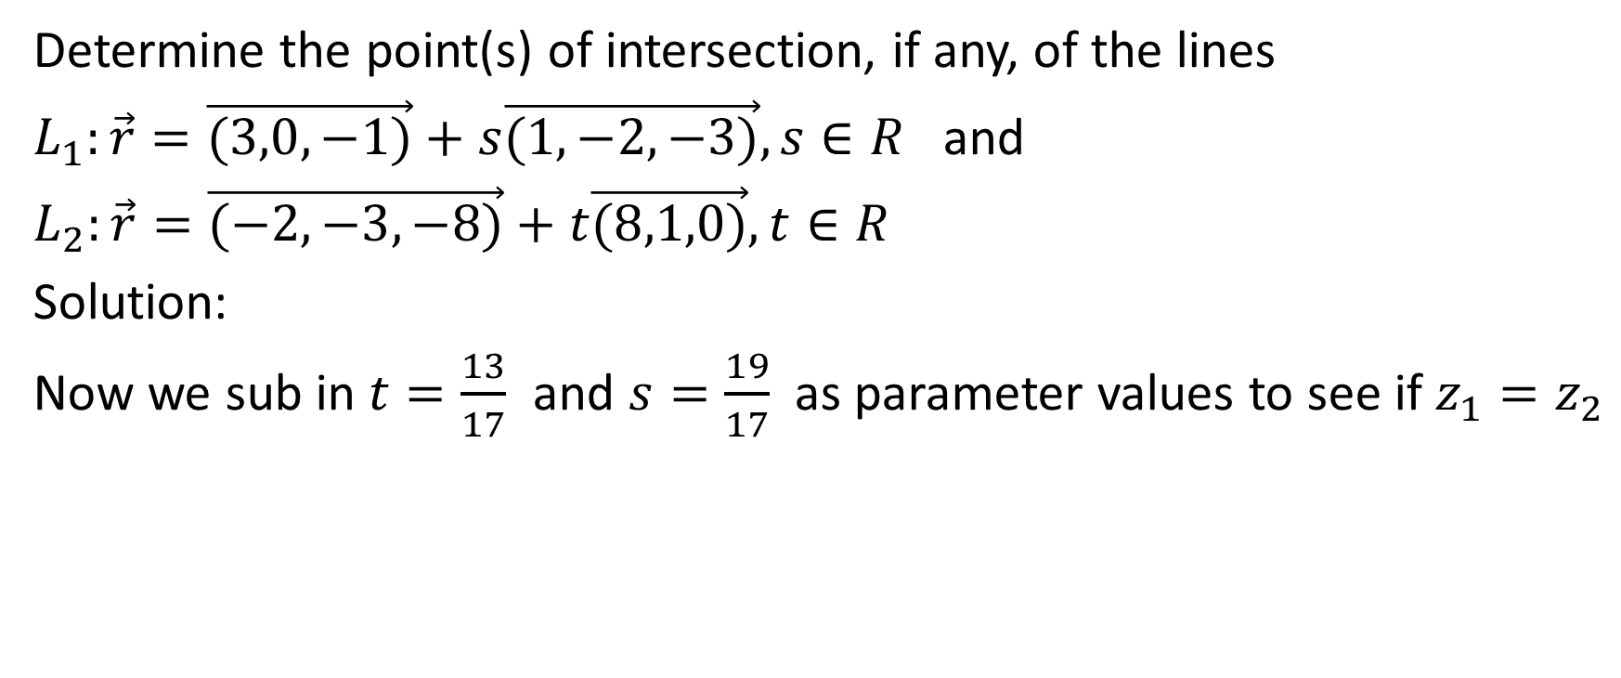
Determine the point(s) of intersection, if any, of the lines
$L_{1}:\vec{r}=\vec{(3,0,−1)}+s\vec{(1,−2,−3)},s∈R$ and
$L_{2}:\vec{r}=\vec{(−2,−3,−8)}+t\vec{(8,1,0)},t∈R$
Solution:
Now we sub in $t=\frac{13}{17}$ and $s=\frac{19}{17}$ as parameter values to see if $z_{1}=z_{2}$

Slide 43
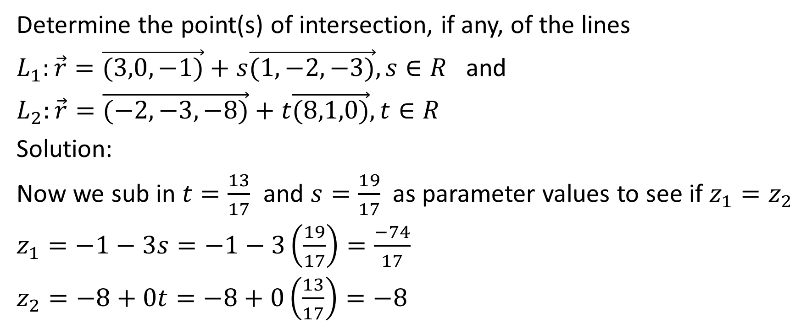
Determine the point(s) of intersection, if any, of the lines
$L_{1}:\vec{r}=\vec{(3,0,−1)}+s\vec{(1,−2,−3)},s∈R$ and
$L_{2}:\vec{r}=\vec{(−2,−3,−8)}+t\vec{(8,1,0)},t∈R$
Solution:
Now we sub in $t=\frac{13}{17}$ and $s=\frac{19}{17}$ as parameter values to see if $z_{1}=z_{2}$
$z_{1}=−1−3s=−1−3\left(\frac{19}{17}\right)=\frac{−74}{17}$
$z_{2}=−8+0t=−8+0\left(\frac{13}{17}\right)=−8$

Slide 44
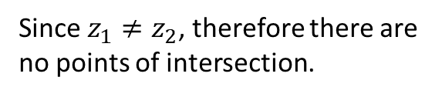
Determine the point(s) of intersection, if any, of the lines
$L_{1}:\vec{r}=\vec{(3,0,−1)}+s\vec{(1,−2,−3)},s∈R$ and
$L_{2}:\vec{r}=\vec{(−2,−3,−8)}+t\vec{(8,1,0)},t∈R$
Solution:
Now we sub in $t=\frac{13}{17}$ and $s=\frac{19}{17}$ as parameter values to see if $z_{1}=z_{2}$
$z_{1}=−1−3s=−1−3\left(\frac{19}{17}\right)=\frac{−74}{17}$
$z_{2}=−8+0t=−8+0\left(\frac{13}{17}\right)=−8$
Since $z_{1}≠z_{2}$, therefore there are no points of intersection.

Slide 45
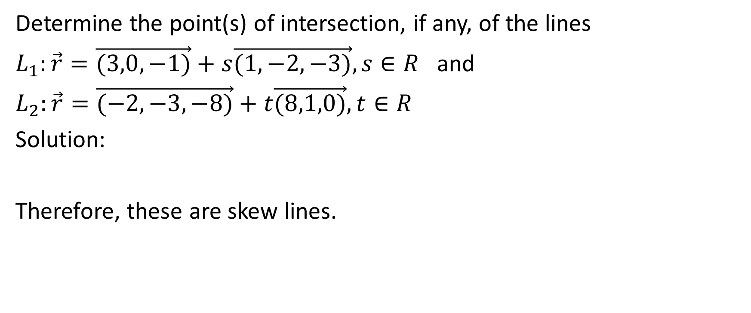
Determine the point(s) of intersection, if any, of the lines
$L_{1}:\vec{r}=\vec{(3,0,−1)}+s\vec{(1,−2,−3)},s∈R$ and
$L_{2}:\vec{r}=\vec{(−2,−3,−8)}+t\vec{(8,1,0)},t∈R$
Solution:
Therefore, these are skew lines.

Slide 46

Example
Determine the point(s) of intersection, if any, of the lines
$L_{1}:\vec{r}=\vec{(−4,−1,−6)}+s\vec{(3,2,−5)},s∈R$ and
$L_{2}:\vec{r}=\vec{(8,7,−26)}+t\vec{(−6,−4,10)},t∈R$

Slide 47
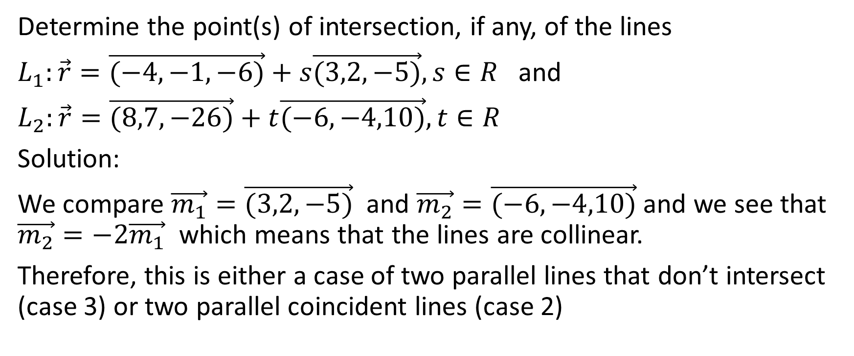
Determine the point(s) of intersection, if any, of the lines
$L_{1}:\vec{r}=\vec{(−4,−1,−6)}+s\vec{(3,2,−5)},s∈R$ and
$L_{2}:\vec{r}=\vec{(8,7,−26)}+t\vec{(−6,−4,10)},t∈R$
Solution:
We compare $\vec{m_{1}}=\vec{(3,2,−5)}$ and $\vec{m_{2}}=\vec{(−6,−4,10)}$ and we see that $\vec{m_{2}}=−2\vec{m_{1}}$ which means that the lines are collinear.
Therefore, this is either a case of two parallel lines that don’t intersect (case 3) or two parallel coincident lines (case 2)

Slide 48
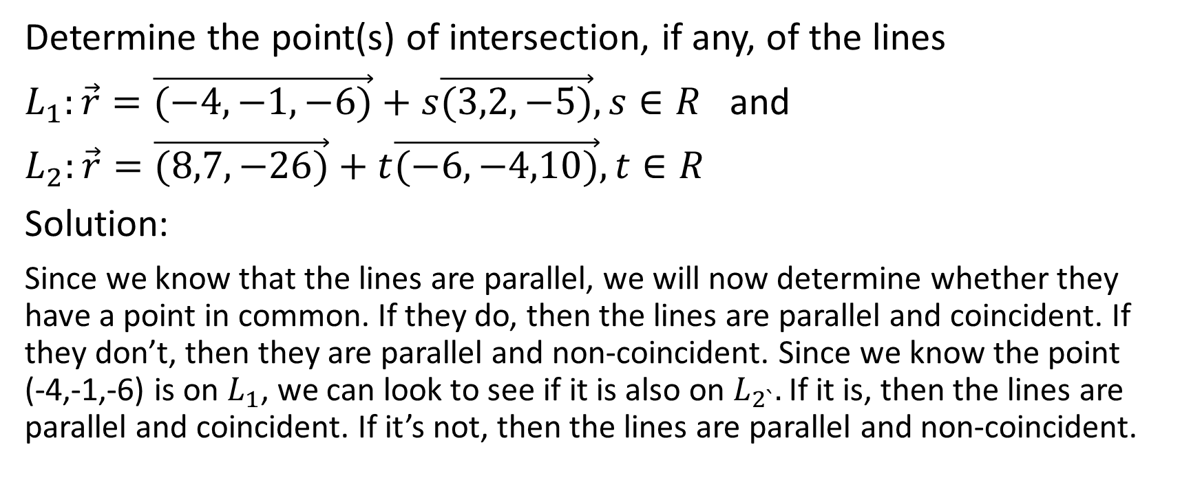
Determine the point(s) of intersection, if any, of the lines
$L_{1}:\vec{r}=\vec{(−4,−1,−6)}+s\vec{(3,2,−5)},s∈R$ and
$L_{2}:\vec{r}=\vec{(8,7,−26)}+t\vec{(−6,−4,10)},t∈R$
Solution:
Since we know that the lines are parallel, we will now determine whether they have a point in common. If they do, then the lines are parallel and coincident. If they don’t, then they are parallel and non-coincident. Since we know the point (-4,-1,-6) is on $L_{1}$, we can look to see if it is also on $L_{2`}.$If it is, then the lines are parallel and coincident. If it’s not, then the lines are parallel and non-coincident.

Slide 49

Determine the point(s) of intersection, if any, of the lines
$L_{1}:\vec{r}=\vec{(−4,−1,−6)}+s\vec{(3,2,−5)},s∈R$ and
$L_{2}:\vec{r}=\vec{(8,7,−26)}+t\vec{(−6,−4,10)},t∈R$
Solution:
(It would be just as effective and efficient to see if the point (8,7,-26) is on $L_{1}$)

Slide 50
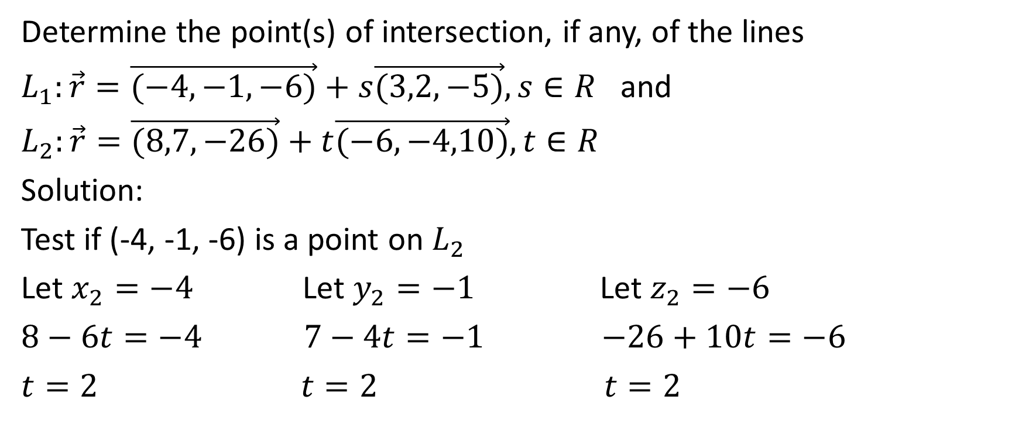
Determine the point(s) of intersection, if any, of the lines
$L_{1}:\vec{r}=\vec{(−4,−1,−6)}+s\vec{(3,2,−5)},s∈R$ and
$L_{2}:\vec{r}=\vec{(8,7,−26)}+t\vec{(−6,−4,10)},t∈R$
Solution:
Test if (-4, -1, -6) is a point on $L_{2}$
Let $x_{2}=−4$ Let $y_{2}=−1$ Let $z_{2}=−6$
$8−6t=−4$ $7−4t=−1$ $−26+10t=−6$
$t=2$ $t=2$ $t=2$

Slide 51
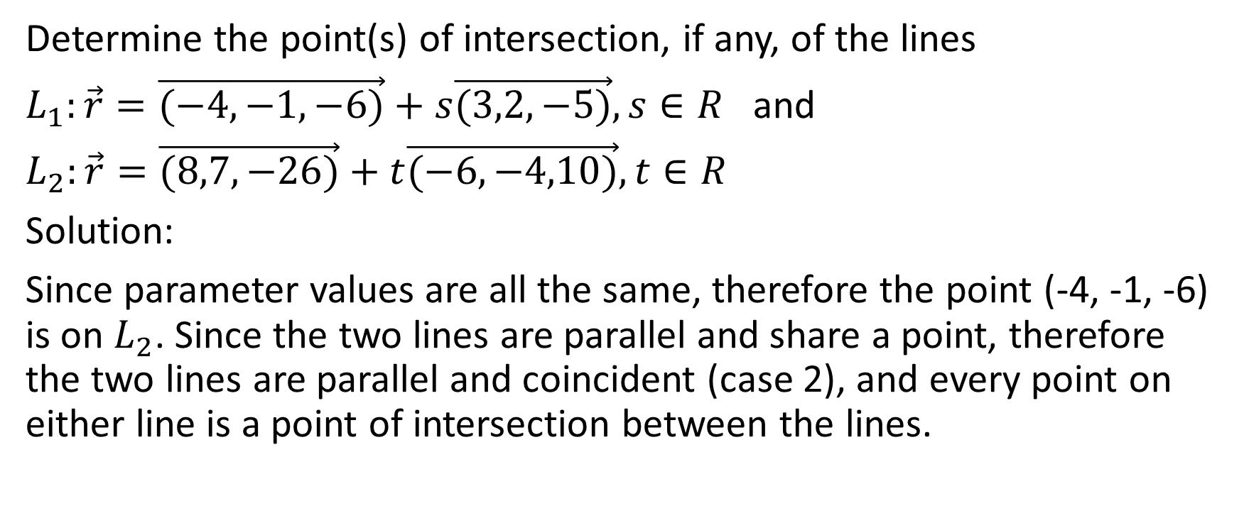
Determine the point(s) of intersection, if any, of the lines
$L_{1}:\vec{r}=\vec{(−4,−1,−6)}+s\vec{(3,2,−5)},s∈R$ and
$L_{2}:\vec{r}=\vec{(8,7,−26)}+t\vec{(−6,−4,10)},t∈R$
Solution:
Since parameter values are all the same, therefore the point (-4, -1, -6) is on $L_{2}$. Since the two lines are parallel and share a point, therefore the two lines are parallel and coincident (case 2), and every point on either line is a point of intersection between the lines.

Slide 52

Example
Determine the point(s) of intersection, if any, of the lines
$L_{1}:\vec{r}=\vec{(−4,−1,−6)}+s\vec{(3,2,−5)},s∈R$ and
$L_{2}:\vec{r}=\vec{(8,7,−16)}+t\vec{(−6,−4,10)},t∈R$

Slide 53
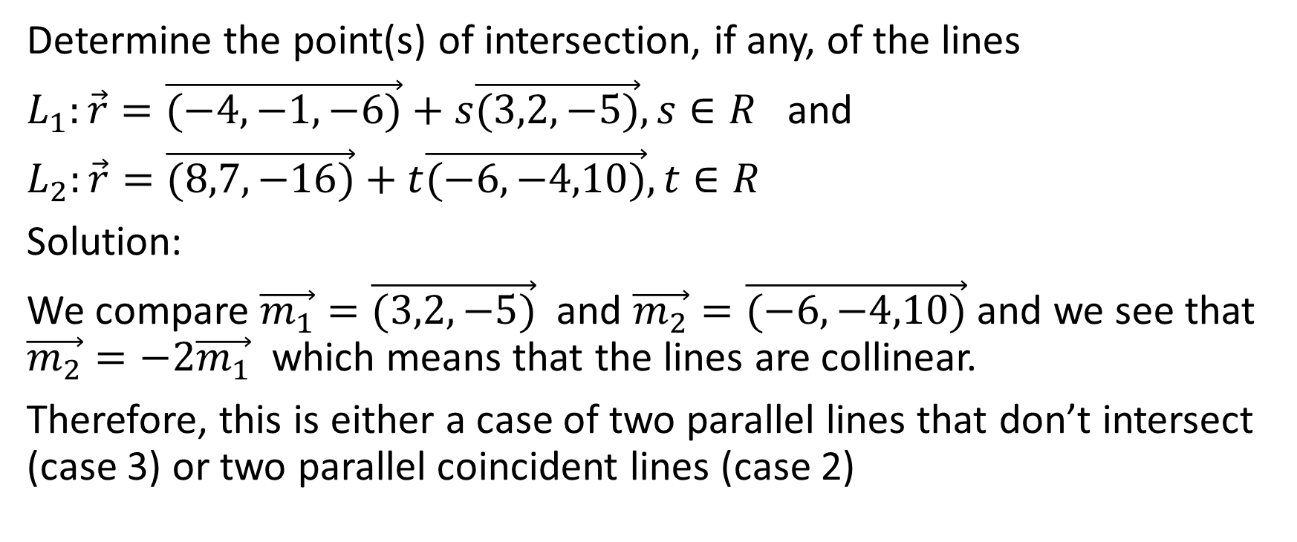
Determine the point(s) of intersection, if any, of the lines
$L_{1}:\vec{r}=\vec{(−4,−1,−6)}+s\vec{(3,2,−5)},s∈R$ and
$L_{2}:\vec{r}=\vec{(8,7,−16)}+t\vec{(−6,−4,10)},t∈R$
Solution:
We compare $\vec{m_{1}}=\vec{(3,2,−5)}$ and $\vec{m_{2}}=\vec{(−6,−4,10)}$ and we see that $\vec{m_{2}}=−2\vec{m_{1}}$ which means that the lines are collinear.
Therefore, this is either a case of two parallel lines that don’t intersect (case 3) or two parallel coincident lines (case 2)

Slide 54
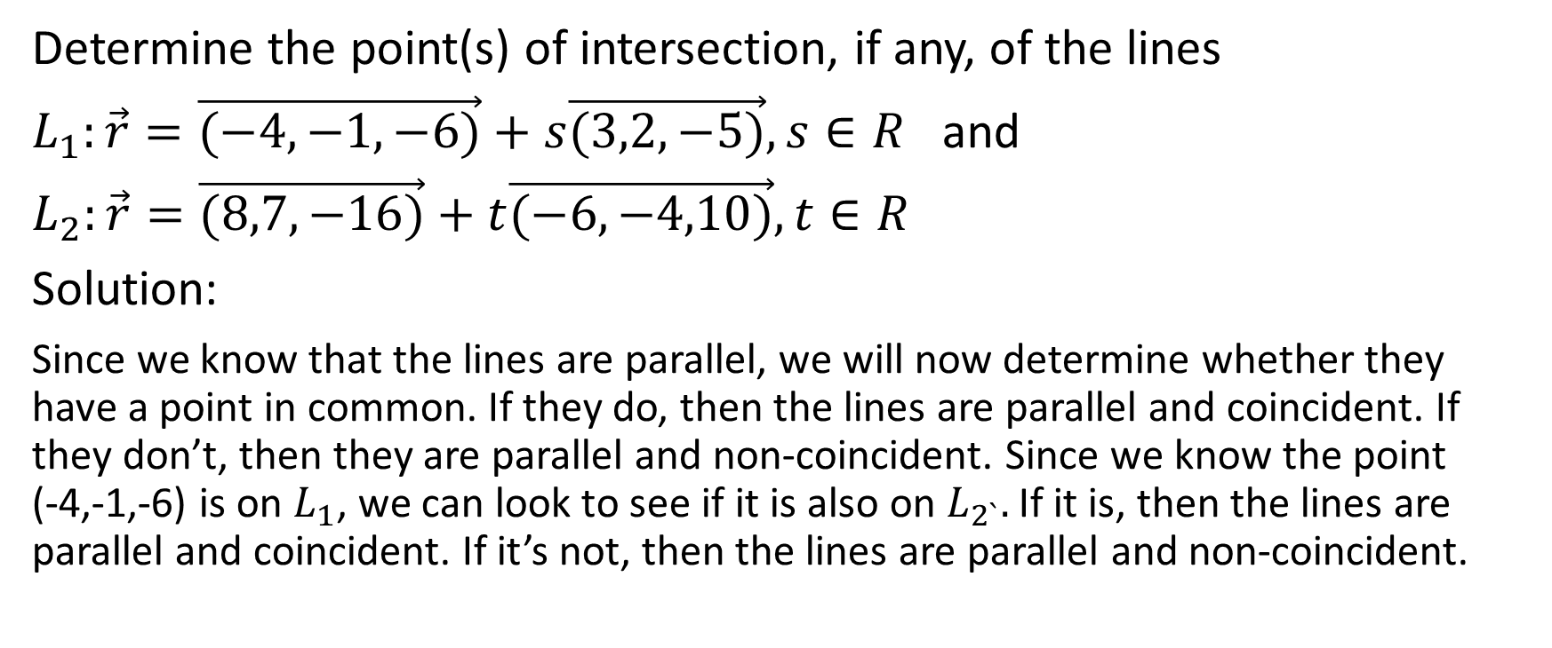
Determine the point(s) of intersection, if any, of the lines
$L_{1}:\vec{r}=\vec{(−4,−1,−6)}+s\vec{(3,2,−5)},s∈R$ and
$L_{2}:\vec{r}=\vec{(8,7,−16)}+t\vec{(−6,−4,10)},t∈R$
Solution:
Since we know that the lines are parallel, we will now determine whether they have a point in common. If they do, then the lines are parallel and coincident. If they don’t, then they are parallel and non-coincident. Since we know the point (-4,-1,-6) is on $L_{1}$, we can look to see if it is also on $L_{2`}.$If it is, then the lines are parallel and coincident. If it’s not, then the lines are parallel and non-coincident.

Slide 55

Determine the point(s) of intersection, if any, of the lines
$L_{1}:\vec{r}=\vec{(−4,−1,−6)}+s\vec{(3,2,−5)},s∈R$ and
$L_{2}:\vec{r}=\vec{(8,7,−16)}+t\vec{(−6,−4,10)},t∈R$
Solution:
(It would be just as effective and efficient to see if the point (8,7,-16) is on $L_{1}$)

Slide 56
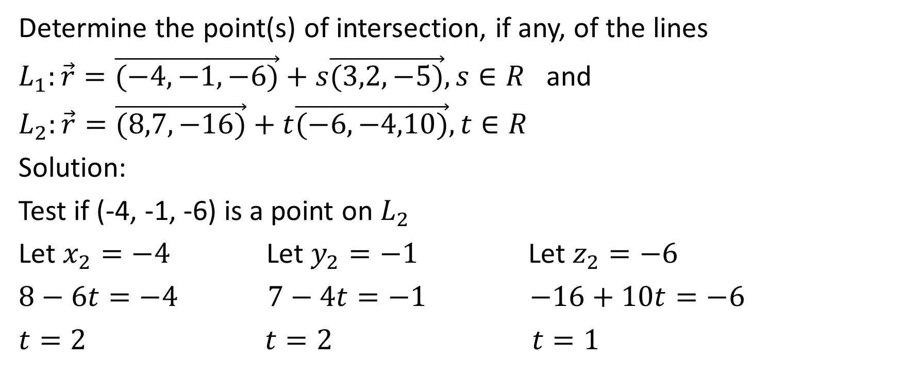
Determine the point(s) of intersection, if any, of the lines
$L_{1}:\vec{r}=\vec{(−4,−1,−6)}+s\vec{(3,2,−5)},s∈R$ and
$L_{2}:\vec{r}=\vec{(8,7,−16)}+t\vec{(−6,−4,10)},t∈R$
Solution:
Test if (-4, -1, -6) is a point on $L_{2}$
Let $x_{2}=−4$ Let $y_{2}=−1$ Let $z_{2}=−6$
$8−6t=−4$ $7−4t=−1$ $−16+10t=−6$
$t=2$ $t=2$ $t=1$

Slide 57

Determine the point(s) of intersection, if any, of the lines
$L_{1}:\vec{r}=\vec{(−4,−1,−6)}+s\vec{(3,2,−5)},s∈R$ and
$L_{2}:\vec{r}=\vec{(8,7,−16)}+t\vec{(−6,−4,10)},t∈R$
Solution:
Since parameter values are not all the same, therefore the point (-4, -1, -6) is not on $L_{2}$. Since the two lines are parallel but there is a point on one of them which is not on the other, therefore the two lines are parallel and not coincident (case 3), and they have no points of intersection between them.

